Slide 1
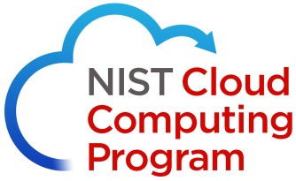
NIST Model of Cloud Computing

Slide 2
NIST
National
Institute
of
Standards
&
Technology
(US Department of Commerce)

Slide 3
Definition of Cloud Computing as per NIST
Cloud computing is a model for enabling ubiquitous, convenient, on-demand network access to a shared pool of configurable computing resources (e.g., networks, servers, storage, applications, and services) that can be rapidly provisioned and released with minimal management effort or service provider interaction.

Slide 4
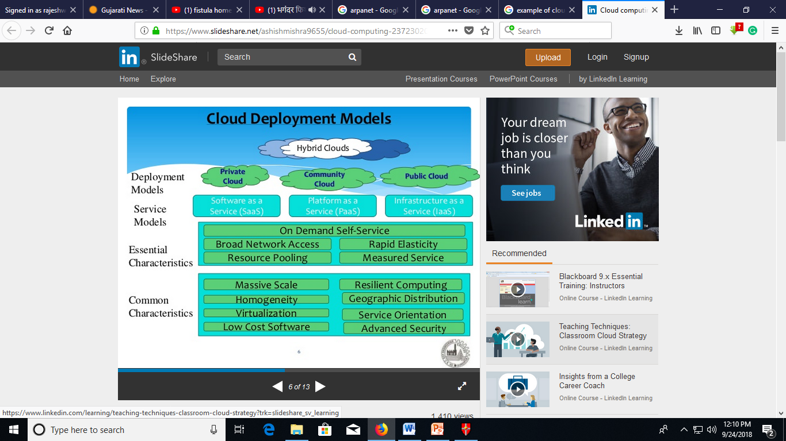

Slide 5
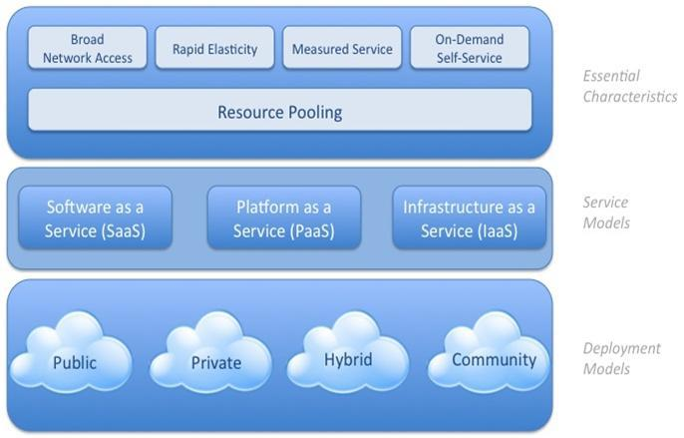

Slide 6
